Slide 1

Establishment of the Regional Database
for the Mediterranean and Black Seas
(RDBFIS-III)
Under framework contract – EASME/EMFF/2020/OP/0021
Specific Contract CINEA/EMFAF/2024/3.1/01/SC08
RCG Med&BS | Steering Committee for the Med&BS Regional Database
16 April 2026

Slide 2

RDBFIS: Overview of RDBFIS Phases I, II, III
MARE/2020/08 - SI2.839444
Development of the Regional Database for the
Mediterranean & Black Seas (Med&BS RDBFIS)
This project has financed under the European Maritime and Fisheries Fund (EMFF)
Phase I
Start: 01/01/2021
End: 28/02/2023
Coordinator: S. Kavadas
CINEA/EMFAF/2021/3.1.2/03/SC04/SI2.881222
Hosting, maintenance and further development of the Regional Database for the Mediterranean and Black Seas
Phase II
Start: 01/04/2023
End: 31/03/2025
Coordinator: S. Kavadas
CINEA/EMFAF/2024/3.1/01/SC08
Establishment of the Regional Database for the Mediterranean and Black Seas
Phase III
Start: 01/04/2025
End: 21/05/2026
Coordinators: I. Maina & S. Kavadas

Slide 3
Key activities
During the third phase of the RDBFIS implementation , in addition to supporting MS in data validation and uploading, as well as addressing specific requirements, the consortium focused on the following objectives:
system maintenance and fine-tuning
finalising the MEDIAS data base structure;
developing the MEDIAS R package (similar to RoME);
developing an R package for statistical analysis;
integration of SDTool package for sampling optimization;
substantially enhancing system performance, with a particular focus on the consistency check phase;
establishing collaboration with other consortia, with the aim of expanding the system through the integration of new components with the aim of enabling MS to use the platform to respond to multiple data requests (JRC, GFCM, ICES);
RDBFIS Transition to EU DIGIT – Collaboration with EU IT Services;
harmonizing RDBFIS with other platforms (JRC, GFCM);
participation in meetings (MED&BS RCG, Liaison, NC DCF meetings, LP RCG, ..)
workshops and internal meetings were organised to support system fine-tuning and development;
Notes:
Actions already performed
Participation in meetings:
MEDIAS SC
MEDITS SC
RCG ECON
RCG LP
SC RDB
MED&BS RCG
DCF Liaison Meeting
NC DCF meetings
A series of dedicated workshops and meetings focusing on fine-tuning and further development have been organised to facilitate the implementation of the project activities.

Slide 4

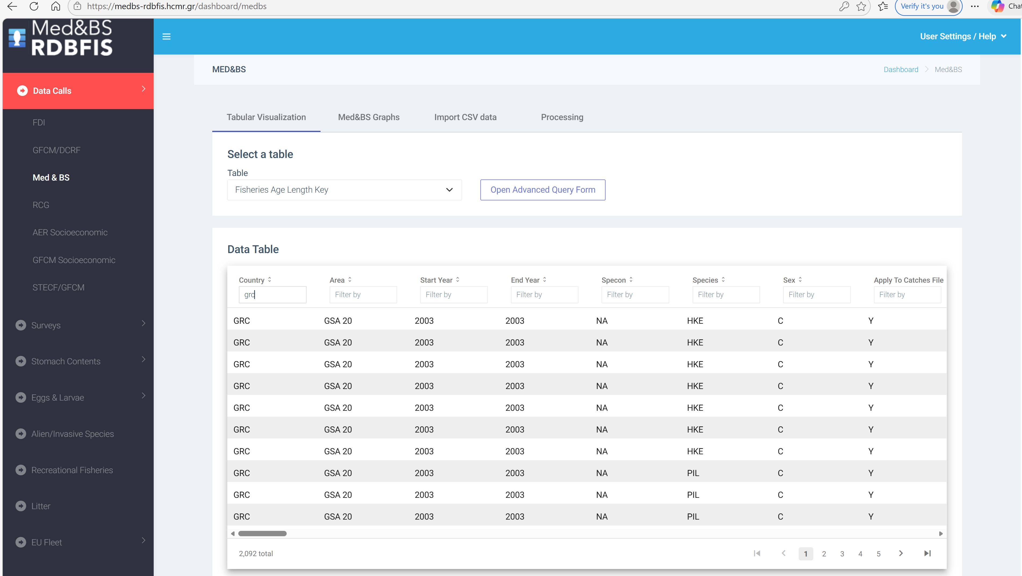
RDBFIS overview
Med&BS RDB
Datacalls: Med&BS, FDI,
GFCM/DCRF
Detailed biological data
Surveys: MEDITS, MEDIAS, Eggs&Larvae
EU Fleet
Stomach content
PETS
Alien species
Recreational
Coding
Environmental
Spatial data
Integrated Components
UI
Validation schemes
FDI spatial checks
RDBqc
RDBprocessing
RoME, RoMEBS
BioIndex
EU fleet analysis
MCDA for SSF
Mapping
Stomach content, Eggs&Larvae data entry forms
MEDIAS R package
stat4RDBFIS R package
SDTool package for sampling optimization

Slide 5
Harmonization across RDBFIS, JRC, and GFCM Platforms
schema & syntactic rules
Multiple platforms (RDBFIS, JRC, GFCM DCRF)
Issues:
Divergent field names
Varying decimal precision tolerance
Code lists applied (species, gears, GSAs)
Different syntactic rules
RDBFIS: The validation scheme implemented in the RDBFIS was strictly aligned with the specifications defined in the various Annexes of the relevant EU/GFCM data calls and the survey handbooks.
The JRC system is more flexible with certain validation rules, particularly regarding the number of digits allowed after the decimal point.

Slide 6
System Harmonization across RDBFIS and JRC (Med&BS datacall)
JRC-RDBFIS meeting, 20 November 2025
Objective: To review and align the technical aspects and data validation rules between RDBFIS and JRC systems, ensuring consistency, interoperability, and accurate data exchange under the DCF / Med&BS datacall framework.
Main topics
Coding Systems and Species Lists
Validation Rules and Numerical Precision
ANNEX 1 Update
MEDITS-Specific Harmonization Issues
Next Steps and Coordination
Actions implemented following the meeting:
The harmonization process between the JRC and RDBFIS databases is nearly complete; a few remaining issues require further discussion and will be included as agenda items for the next meeting.
Regarding the MEDITS structure and validation rules, these will be addressed at the next meeting with JRC as: (a) the new MEDITS Handbook has been finalised and published, and (b) the outcomes of the meeting between RDBFIS and the MEDITS Chair have been circulated within the MEDITS group for review and agreement.

Slide 7

System Harmonization across RDBFIS and GFCM/DCRF datacalls
GFCM-RDBFIS meeting, 26 November 2025
Objective: To address the technical harmonization needs between the GFCM Data Collection Reference Framework (DCRF) and the RDBFIS platform.
Main topics
Participants from the RDBFIS consortium, DG MARE, and the GFCM Secretariat examined the current integration status, coding systems, data validation processes, spatial inconsistencies in GSA polygons, and upcoming changes in the DCRF structure.
Next meeting: GFCM will set the date

Slide 8
Harmonization among RDBFIS and MEDITS
MEDITS Chair and RDBFIS Consortium online meeting, 2 December 2025
Objective: Revision of the MEDITS new Handbook and species list
Main topics
The discussion focused on:
assessing the impact of the changes introduced in the MEDITS data structure on the RDBFIS platform, including the database, the integrated R packages (RoME, BioIndex, and RDBQC), the backend, frontend, and validation schema (reordering of the column NUMBER_OF_THE_STRATUM in table TA, removal of the columns CODEND_CLOSING and PART_OF_THE_CODEND from tables TA and TB, addition of new columns-STATION_NUMBER and DOOR_OPENING to table TA);
Matching of the MEDITS TM species list with WoRMS and ASFIS.
Actions: the outcomes of the meeting has been circulated within the MEDITS group for review and agreement.

Slide 9
Identical data sets between RDBFIS and JRC
RDBFIS supports advanced data extraction through filtering and query-building functionalities, enabling users to retrieve subsets of data based on specific criteria, without the need to download complete datasets. This facilitates efficient access, extraction, and sharing of data by the Med&BS RCG, NCs and other authorized users. In contrast, while the JRC system allows data downloads, it does not currently support filtering or query capabilities.
This functionality within RDBFIS significantly enhances efficiency in handling large datasets, improves usability for scientific analysis and modelling workflows, and increases flexibility for MS and research groups. Given that these datasets are frequently used in collaborative research contexts, including the formation of consortia and the preparation of project proposals, ensuring consistency across platforms is of critical importance.
Beyond analytical applications, maintaining identical datasets is equally important for supporting downstream outputs such as reports, scientific publications, management plans, stock assessment models and spatial analyses (e.g. mapping activities).
In conclusion, it is essential to guarantee that, regardless of the platform used (RDBFIS or JRC), the datasets retrieved are fully consistent and identical.

Slide 10
RDBFIS datacalls
AIM: Populate the RDBFIS with data
The population of the RDBFIS with data began in December 2023. Following a data call, the JRC provided to the consortium the requested time series (2002–2022) covering aggregated and MEDITS datasets. Other data calls relate to the submission of historical detailed biological data, as well as MEDIAS acoustic processing data, pelagic trawl and CTD raw data.
Member States were invited to upload their data into the RDBFIS, performing syntax and validation checks prior to submission. During this process, several MS modified their datasets.
Further considerations include scenarios in which a MS may request the resubmission of data (e.g. Croatia, Italy, Greece), as well as the import of MEDITS datasets for the period 1994–2001.

Slide 11
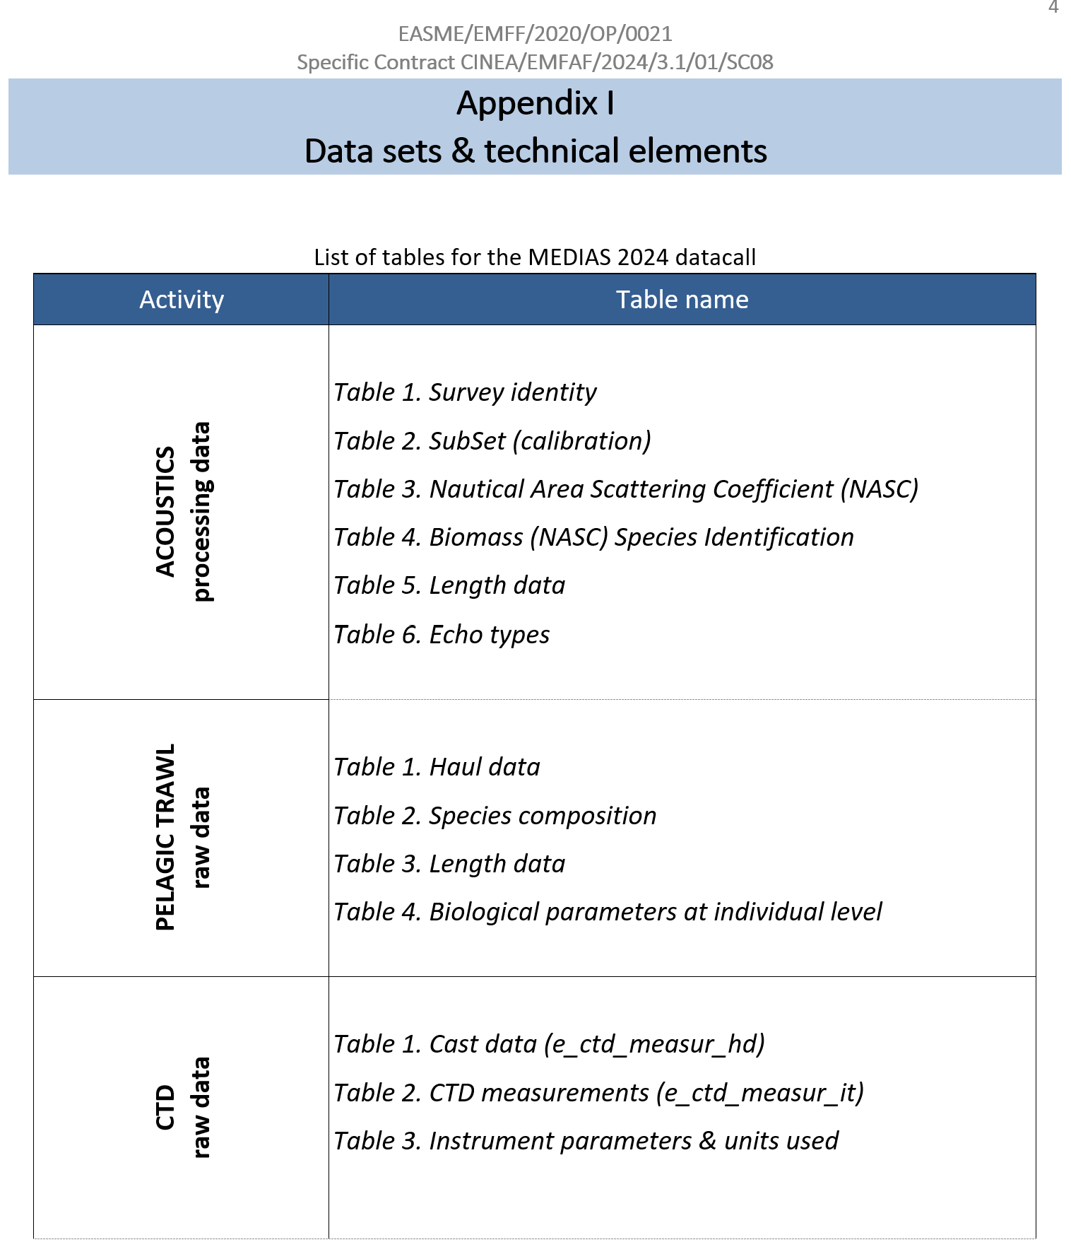
Data call for acoustics, pelagic trawl and CTD data
collected from 2024 surveys in the Med&BS
Aim: to populate the system with relevant datasets collected during 2024 MEDIAS survey (deadline 17/3/2026).
The RDBFIS consortium was available during the whole period of the data call arranged bilateral meetings, to facilitate the process, demonstrated the different tools in place and solved any issues that arised.
Discussion during the MEDIAS Annual Meeting (end of April 2026) on identifying the most appropriate time of the year to launch the data call …

Slide 12
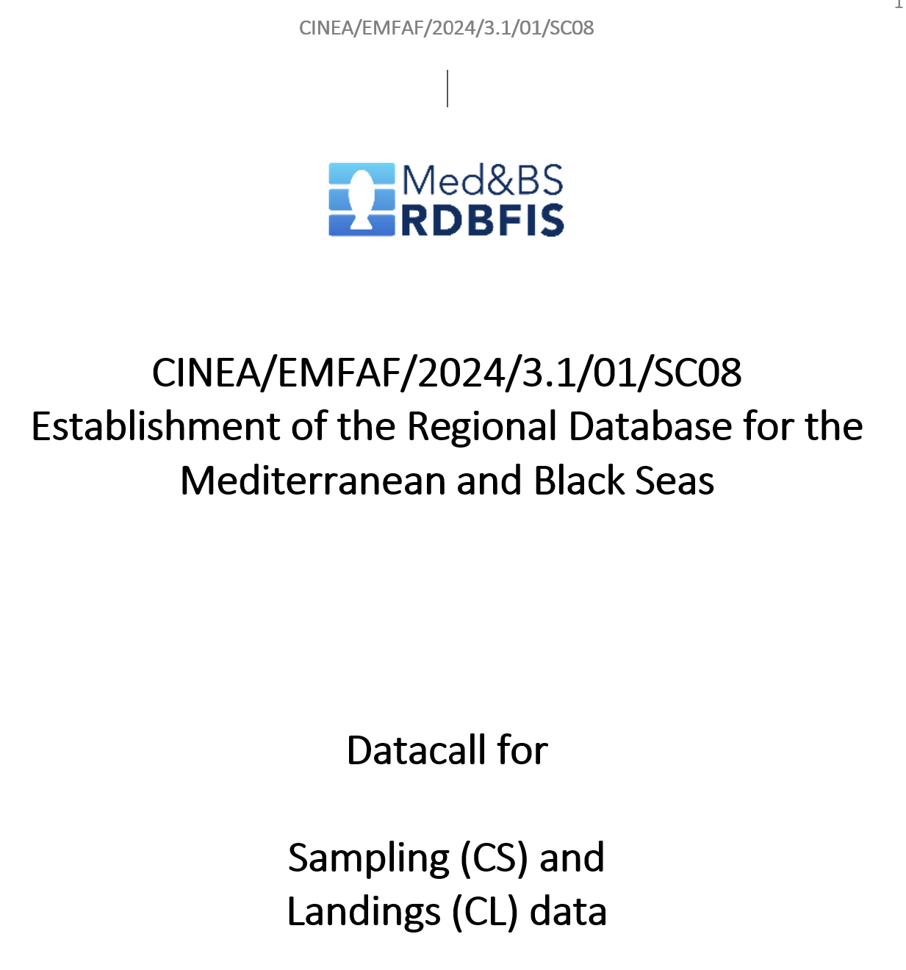
Data call for sampling (CS) and landings (CL) data
Aim: to populate the RDBFIS with sampling (detailed biological data) and aggregated landings data collected under the Data Collection Framework (DCF) during the 2025 implementation period.
Discussion on identifying the most appropriate time of the year to launch the data call
suggest: 30 calendar days before the official Med&BS and FDI datacalls

Slide 13
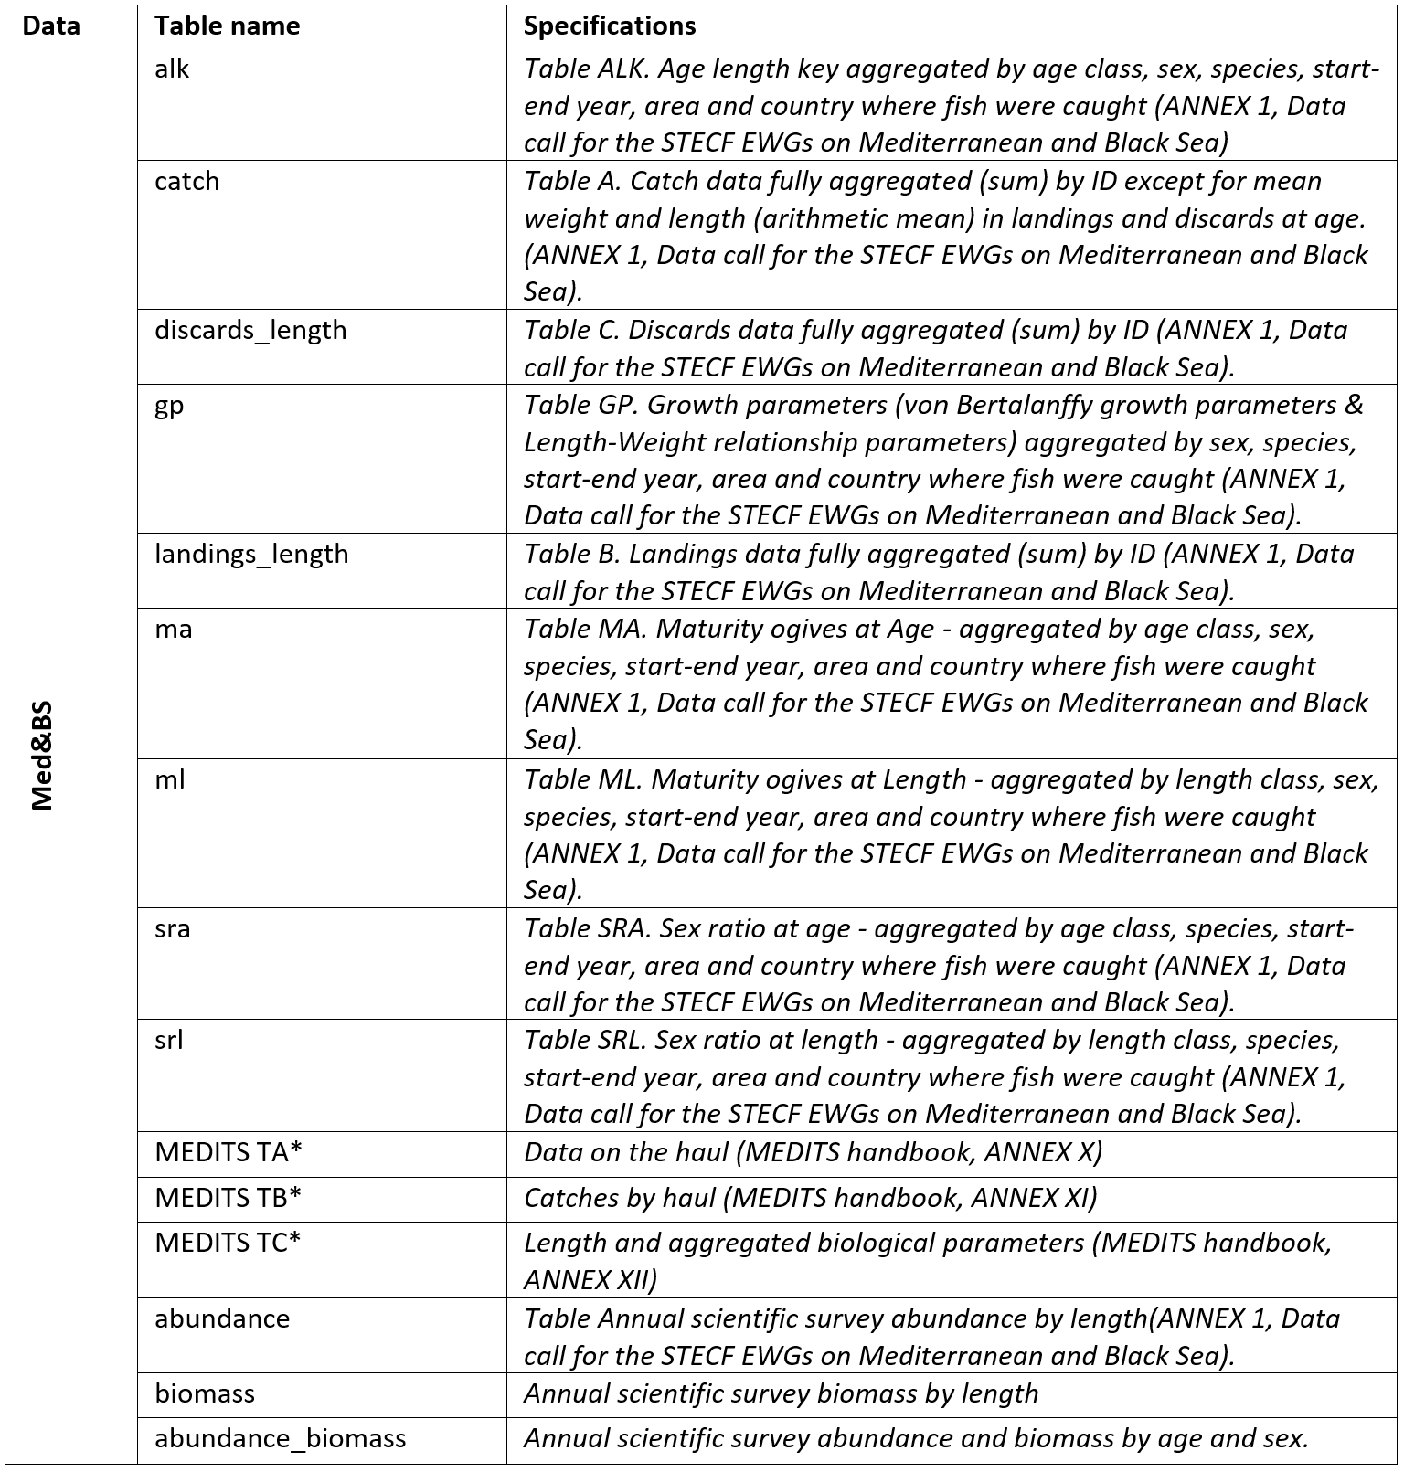
Med&BS Data call
DG MARE official datacall
Usually, the deadline for data submission is set for the last week of June, while the operational deadline is in mid-August.
RDBFIS
The aim is to populate RDBFIS annually with biological and MEDITS data.
suggest: To populate RDBFIS with data, could we follow the timeline set by DG MARE for launching the data call and establishing both the submission deadline and the operational deadline?

Slide 14
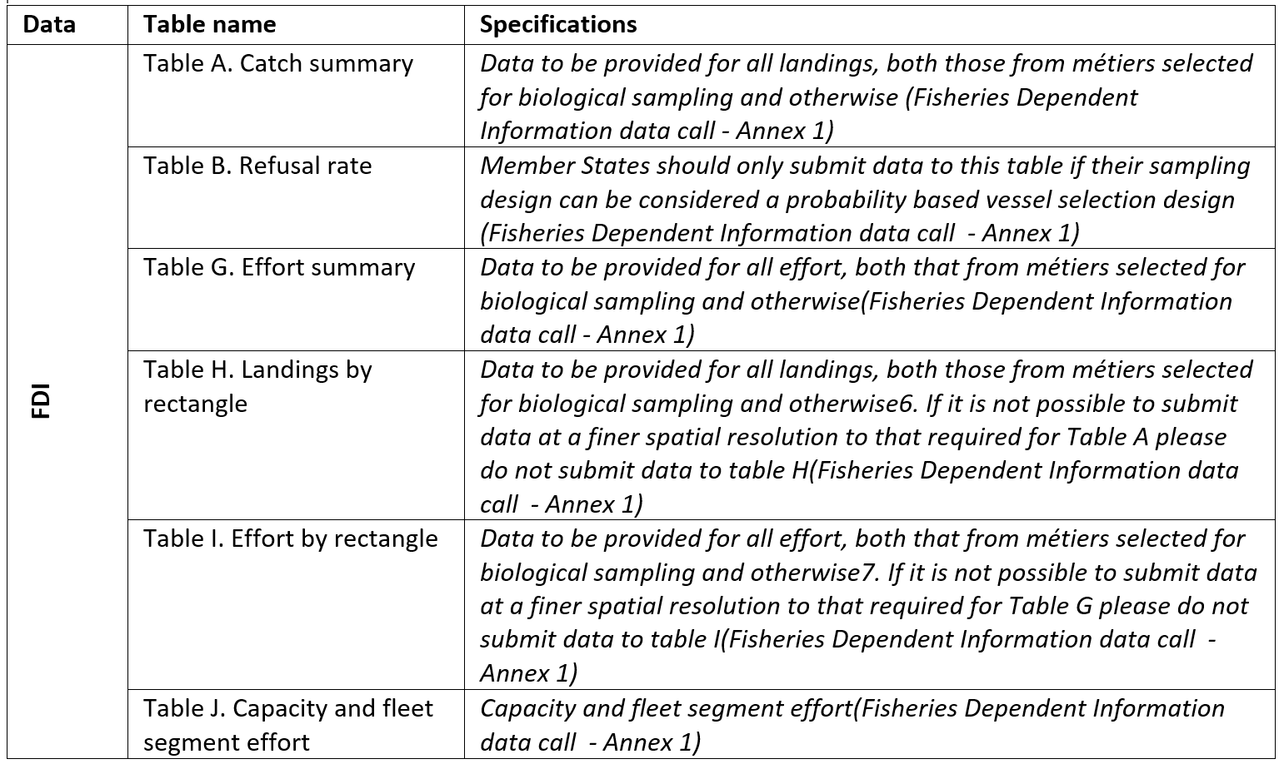
FDI Data call
DG MARE official datacall
Usually, the deadline for data submission is set for the last week of June, while the operational deadline is in mid-August.
RDBFIS
The aim is to populate RDBFIS annually with catch, effort, landings by rectangle, effort by rectangle and capacity data.
suggest: To populate RDBFIS with data, could we follow the timeline set by DG MARE for launching the data call and establishing both the submission deadline and the operational deadline?

Slide 15
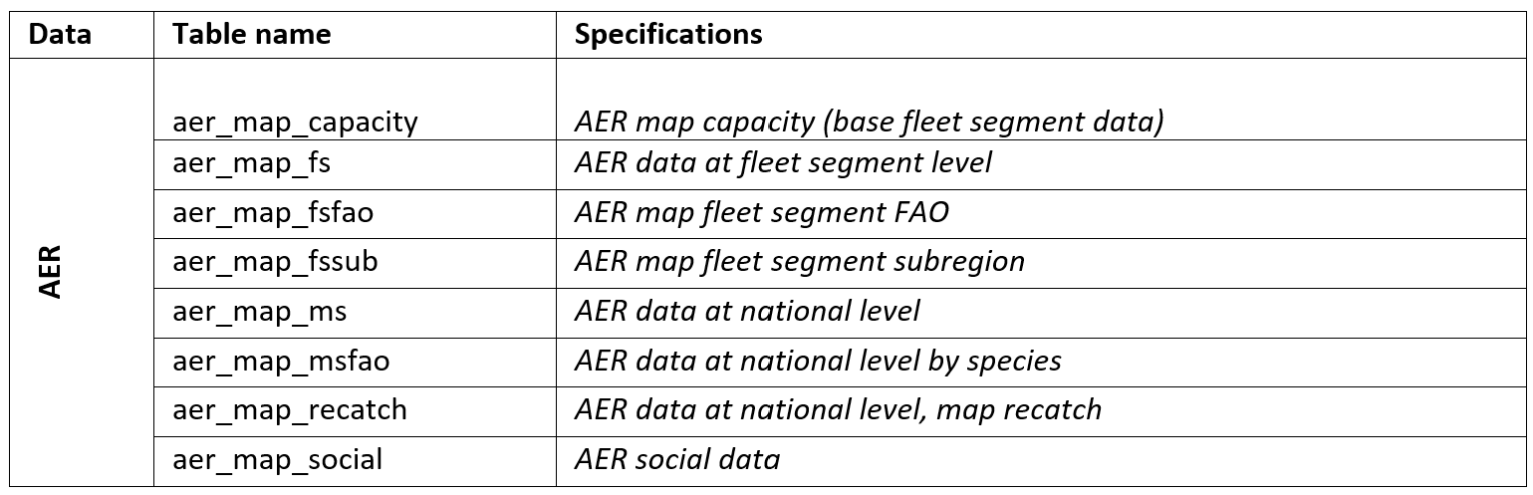
AER Data call
DG MARE official datacall
Usually, the deadline for data submission is set for the last week of February
RDBFIS
The aim is to populate RDBFIS annually with AER data
suggest: To populate RDBFIS with data, could we follow the timeline set by DG MARE for launching the data call and establishing both the submission deadline and the operational deadline?

Slide 16
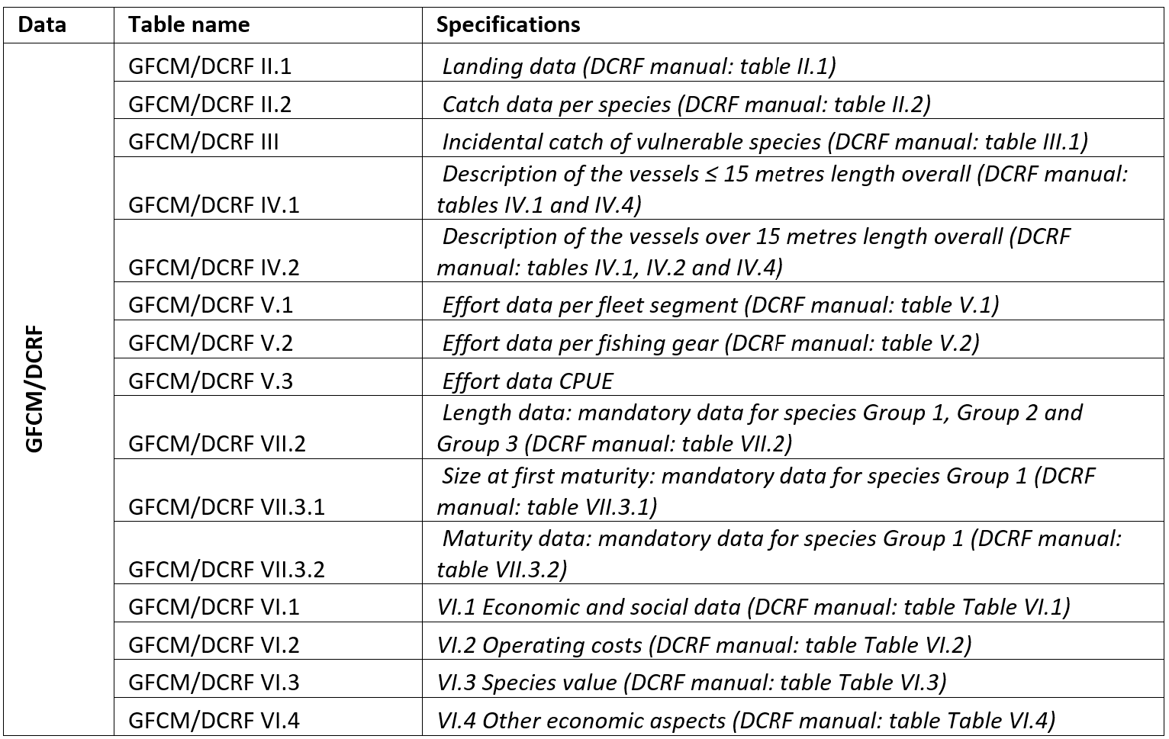
GFCM/DCRF Data call
GFCM official datacall
Data requests from the GFCM occur almost continuously throughout the year.
RDBFIS
The aim is to populate RDBFIS annually with GFCM/DCRF data
suggest: To populate RDBFIS with data, could we follow the timeline set by GFCM for launching the data call and establishing the submission deadline?

Slide 17
Data Quality Assurance and Validation, raising procedures
stat4RDBFIS R package development
The package incorporates information from bilateral meetings conducted during the implementation of RDBFIS I and RDBFIS II, along with insights from the statistical workshop for raising procedures.
RDBFIS III actions and achievements
bilateral meetings with experts from the Med&BS clarified MS specific procedures
10+ core team technical meetings supported the implementation
Implementation phase - developed modules:
Consistency and quality checks of RCG data
Landings and Discards LFDs
Discard ratio estimation
Maturity, sex ratio, and Age-Length Key (harmonized procedures)
R package integration within the RDBFIS

Slide 18
Establishing collaboration with other consortia and ICES
A constructive collaboration between the DIASPARA and RDBFIS consortia has been initiated, with the aim of starting technical discussions on potential pathways for future integration.
DIASPARA is exploring suitable long-term hosting solutions for the database, including RDBFIS and RDBES. In this context, information exchange, bilateral discussions, and joint reflection are encouraged. Cooperation should aim at sharing knowledge, aligning perspectives, and planning for future continuity.
The general approach is that diadromous data collected under the Med&BS framework will be hosted within RDBFIS, supporting functionalities such as data syntax checks, consistency checks, data uploading, and the generation of data calls.
The DIASPARA consortium has provided detailed information on the diadromous database, and meetings are planned to take place during 2026 to further discuss the integration process.

Slide 19
new components for integration
PETS
Alien species
Recreational fisheries (?)
Adaptation of the core EchoR package functions to the RDBFIS format

Slide 20
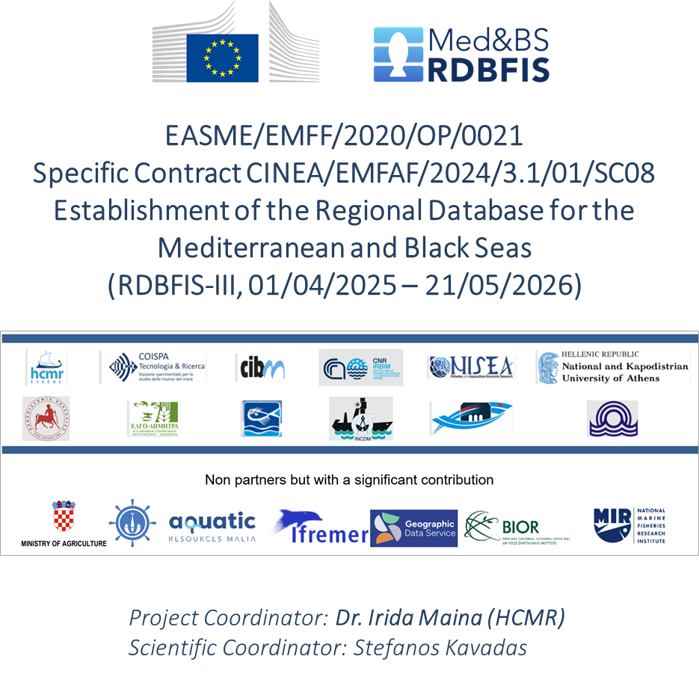
Med&BS RDBFIS-III: Comments & Discussions
Thank you for your attention

